Slide 1
Mapping FOAs
Across time and data collection instruments

Slide 2
Result
33 FOAs → 22 Improvements → 16 impacts

Slide 3
What is the challenge?
FOAs have changed names over time.
FOAs are named differently across data collection tools: Sometimes, questions were phrased referring to a technology or to an improvement.
If the data is to be comparable across instruments, and if the analysis is expected to conduct aggregations, a mapping should be conducted.
*Remember. There are 4 main data sources used for the analysis:
Historical list of projects supported
NLO 1
NLO 2
CP

Slide 4
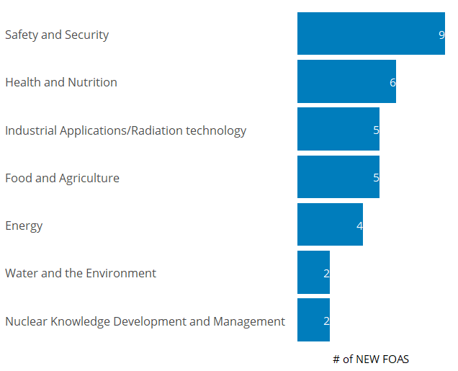
New Naming
A new naming convention was developed. However, the list of historical projects does not contain information about this new naming.
Summary:
The 136 “Old FOAs” were grouped into “33 New FOAs”:

Slide 5
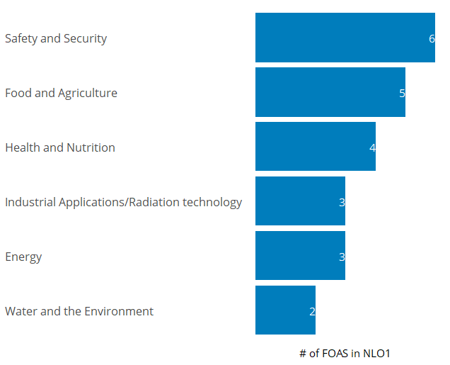
Use of the FOAs in NLO1
Although the NLO1 included questions about the perception of the progress made on each FOA, the questions were phrased referring to the outcome expected in each FOA and not the FOA explicitly.
For example:
New FOA 04 “Energy Planning”: questions related to it were phrased as “Improve energy planning and inform policies to meet future energy needs”
Summary:
22 FOAs in NLO1

Slide 6
Use of FOAs in CP
As for NLO1, in the CP’s the questions related to FOAs were phrased referring to the improvements expected in each FOA.
For example:
New FOA 05 “Introduction of nuclear power”: the questions related to it were phrased as “Safe and sustainable introduction, operation, and lifetime management of nuclear power plant/ nuclear fuel cycle”.

Slide 7
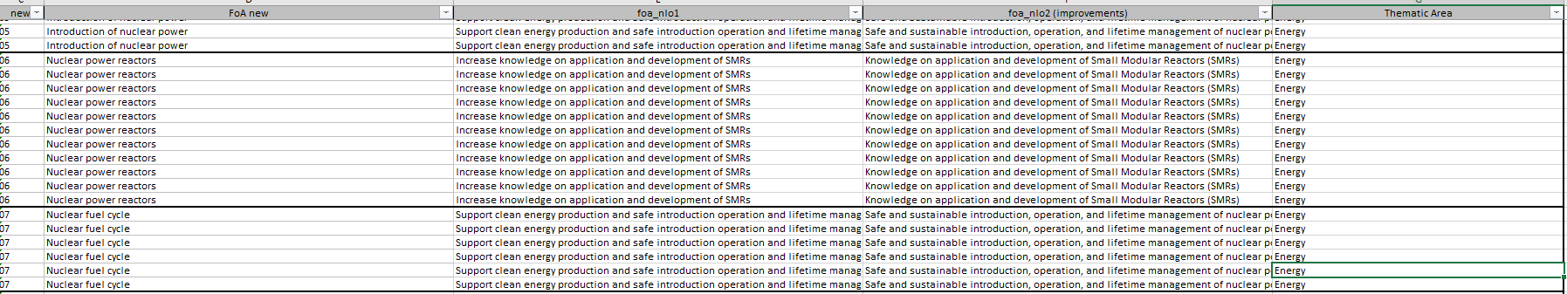
Mapping across NLO surveys
As with the old and new naming, the way in which the FOAs were asked in the NLO surveys were mapped against each other. And this mapping was also mapped against the old and new naming:
Example:
* The full mapping is attached in the email

Slide 8
All the mapping in one file
As a result of this process, a single file was created (an excel file). This file can be used as a “dictionary” to move across FOAs’ naming between data sources.
This file, allows to compare answers between surveys, and to aggregate responses using a single naming convention. Whichever naming is more convenient for the analysis or the audience.

Slide 9
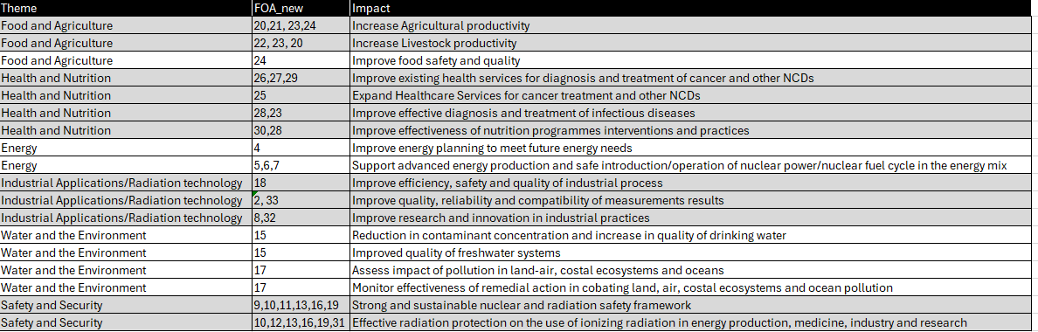
Impacts
Finally, all the NEW FOAs were associated to an expected impact. The objective, is to understand, for every FOA, what impact is expected from the support provided by the TCP:
Having a complete map, or association, between FOAs, improvements, and impact, will allow to conduct an analysis that explores the effectivenesss of the assumptions of the mechanisms in which the TCP is expected to achieve its objectives.

Slide 10
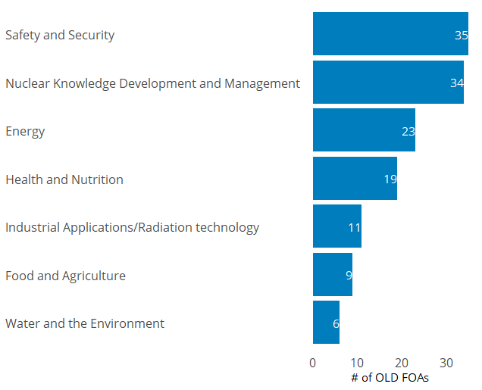
Old Naming
An old ID system and naming convention is used in the data that contains all the projects supported by the TCP historically.
Summary:
There are 136 “Old FOAs”, distributed as follows:

Slide 11
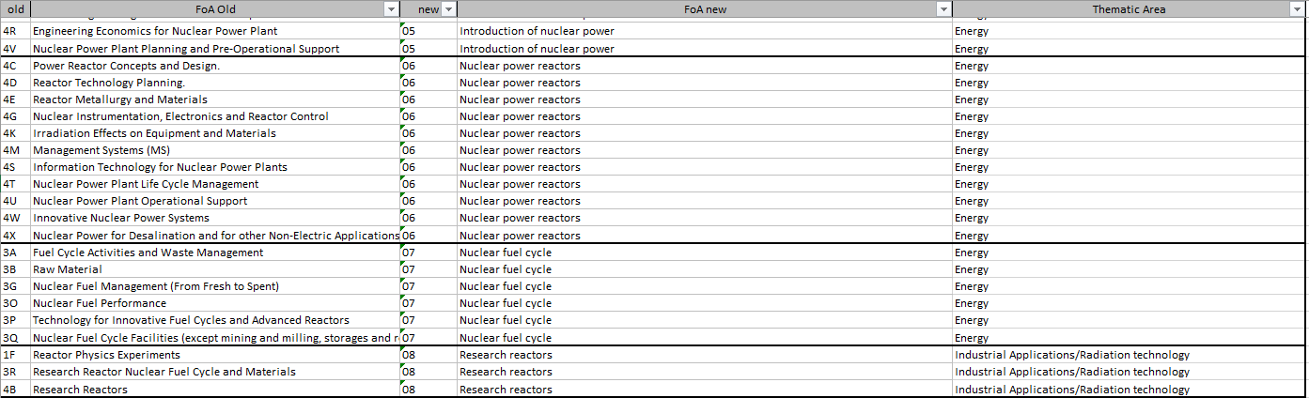
Mapping Old and New names
A mapping was conducted to match old names with new ones. Example of how the mapping looks like:
* The full mapping is attached in the email

